Slide 1
The Cannabis Business – Understanding OSHA and Workers’ Compensation
HR
SAFETY
TRAINING
ON-BOARDING

Slide 2
Participant Questions
Due to the number of attendees, all attendees will be muted
If you should have any questions, please direct them to:
info@strattonagency.com.
Please make sure you mention this webinar date and which company you represent. Also include your phone number as we may want to contact you for a more complete answer or question clarification.
You may also use the question box at any time during the presentation!
If you are a current Human Resources Client, you may also contact your HR Representative at 925-556-4404

Slide 3
A Copy of this Presentation
Clients
Email to info@strattonagency.com
Subject line:
“I would like a copy of the 2017 OSHA & WC Cannabis Presentation” – Dropbox is required!
Non-clients
Email to dbach@strattonagency.com
Subject line:
“I would like a copy of the 2017 OSHA & WC Cannabis Presentation”. Deisy Bach will contact you personally! – DropBox is required!
Copies of this presentation will be sent out on pdf format only.

Slide 4
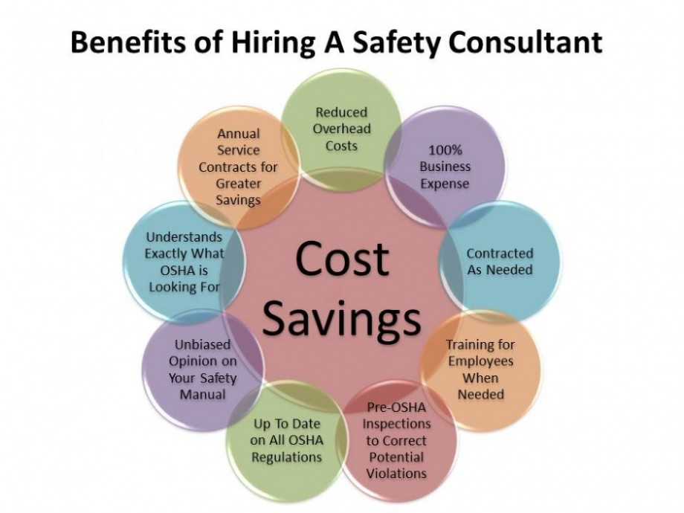
Presenter’s Bio
Ted Schwartz has been in the Human Resources/Safety field for about 14 years. Prior to that, Ted was a Police Office for 16 years.
Those two fields make for a unique understanding of the legal aspects of the Human Resources field including extensive experience in the following areas not usually found in the Human Resources:
Previous OSHA Outreach trainer for 8 years;
Human Resources Investigator including OSHA, EEOC, DFEH, and NLRB with a very high success rate of resolve;
Specialist in trainings such as drugs, narcotics, alcohol and probable cause field testing;
Specialist in Emergency Action Plans and Active Shooter Incidents; and
Specialist in Injury & Illness Prevention Plans, Respirator Protection Plans, and Chemical Hazards Communication Plans.

Slide 5
How Human Resources and Safety Have to Coincide!
How important is it to have a Handbook that works with your Safety Programs?
One cannot work well without the others! Having a written safety program is only as good as your Handbook.
They both must “talk” to each other! It cannot be understated that having an Human Resources AND Safety company that can do both is paramount to your success!

Slide 6
Cannabis Use in the Workplace
Medical Cannabis
Reasonable Accommodation
Recreational Cannabis
Cannabis Additives
Nutrients
Fertilizers
CBD
No measurable amount of THC
May have some medical use
THC
Tetrahydrocannabinol – is the principle psychoactive constituent of Cannabis

Slide 7
The Permit Process
Your business has now gone through the entire complicated and arduous permit process.
Now that the easy part is done, you have to hire employees and safely operate what you hope to be a long-term profitable business!
Understanding the basics to OSHA Safety and Worker’s Compensation will make you business much more profitable!

Slide 8
Human Resource Laws
We will discuss in generalities as there are more than one state involved where you might want to start up your business and each state will have some specific safety requirements.
There are some federal laws you must follow even though Cannabis is still illegal at the federal level.
That alone makes complying with federal safety laws very problematic and difficult especially with the federal agencies you will be dealing with.

Slide 9
Governmental Agencies
No matter what state you are in, typically you will have to comply and deal with the following agencies:
OSHA
Food & Drug Administration
Department
of Agriculture
Department
of Transportation
Drug Enforcement Administration
State Agencies

Slide 10
OSHA Fine Structure – as of 1/1/2017
OSHA’s maximum penalties, which have not been raised since 1990, have increased by 78%.
Other than serious will be under $7,000 ea.
The top penalty for serious violations is $12,471 ea.
The maximum penalty for willful or repeated violations is $124,709 ea.
Businesses can be shut down by Cal OSHA for not having Workers’ Compensation.
Fines can be stacked.
Penalty assessment amounts will be raised annually!
When a death occurs, there may also be criminal issues including significant fines, probation or imprisonment!
In the case of a death, a civil “wrongful death” lawsuit may take place.

Slide 11
The Fine Process
Most state laws dealing with the permit process for Cannabis businesses have steep fines and loss of licenses should you violate your permit(s).
Did you know that most safety laws have fines, penalties, and in some cases owners and managers can go to prison for some safety violations?

Slide 12
The Fine Process – A Little Quiz
Blocked exits and exit routes, fire extinguisher locations not marked, electrical panels blocked:
$1,400.00
$10,900.00
$103,000.00
$156,000.00

Slide 13
The Fine Process – A Little Quiz
Investigated fire at facility, failed to maintain working fire extinguishers:
Investigated fire at facility, failed to maintain working fire extinguishers
$12,500.00
$54,000.00
$87,000.00
92,000.00

Slide 14
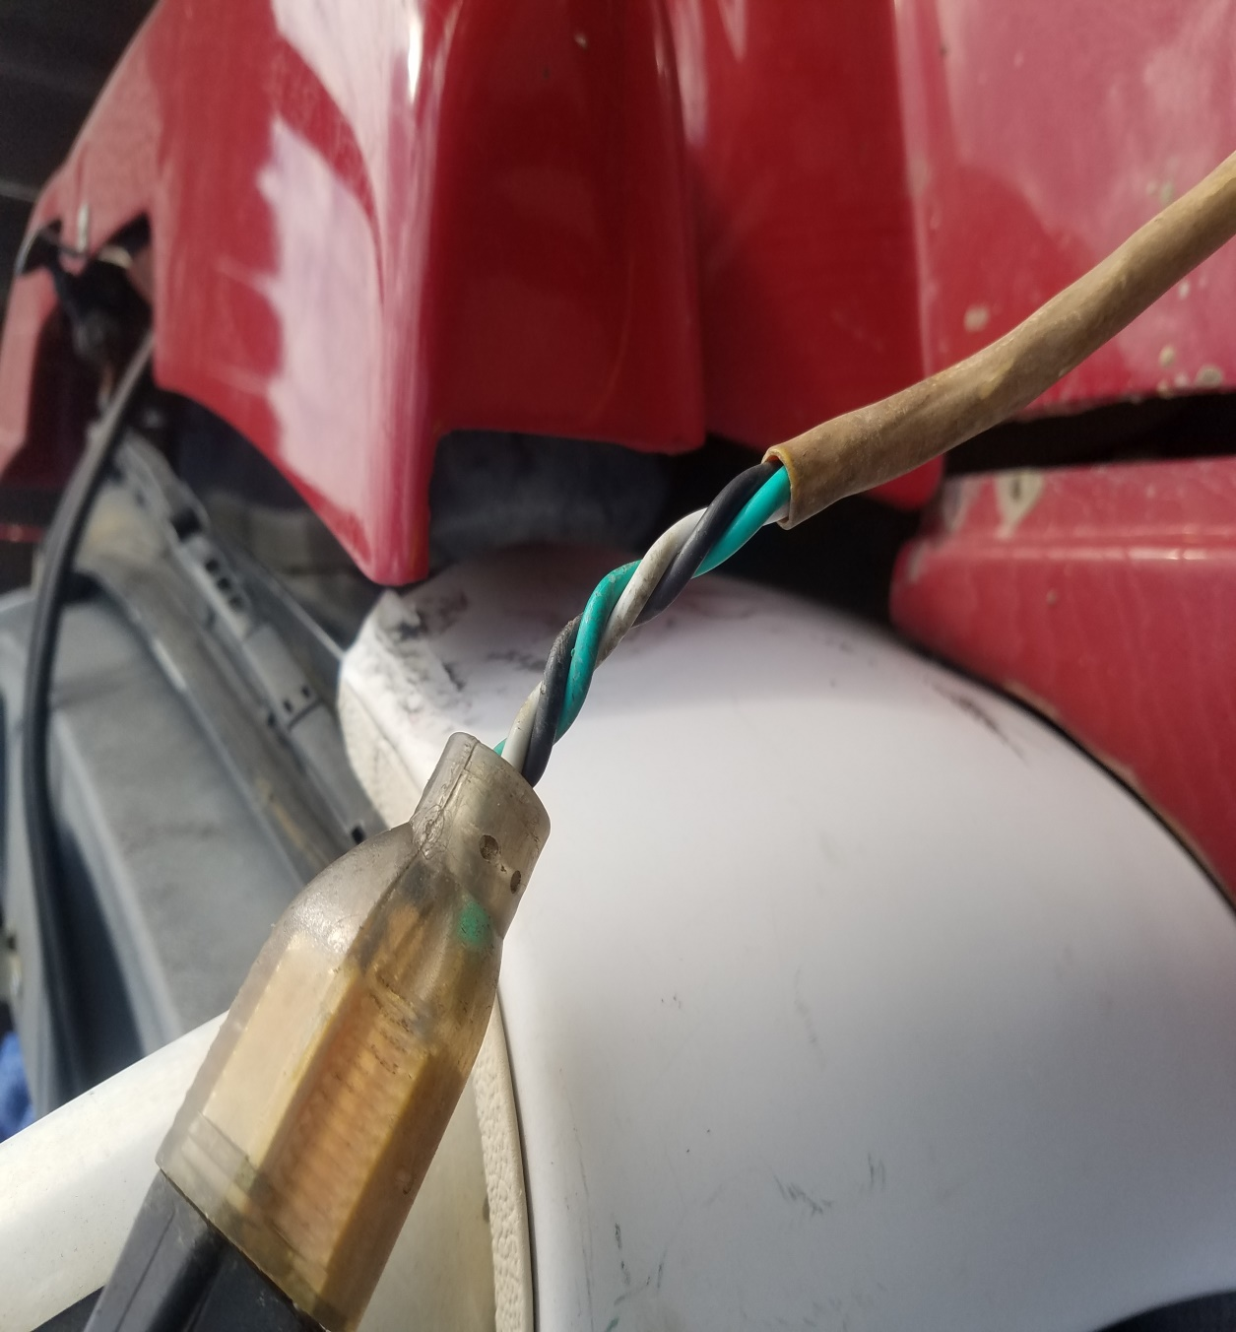
The Fine Process – A Little Quiz
Failure to guard electrical devices, provide standard railing and handrails, lack of an effective Hazard Communication Plan, exposing employees to electrical hazards, allowing build-up of combustible materials
a
b
$84,000.00
$127,000.00
c
d
$214,000.00
265,000.00

Slide 15
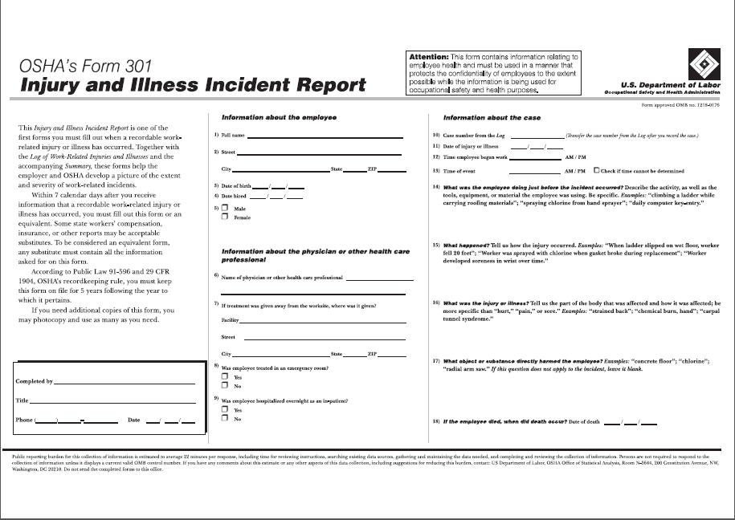
The Fine Process – A Little Quiz
Failing to report employee illness, exposing workers to infectious bacteria, failure to complete OSHA Form 301, failure to record injury or illness within seven (7) calendar days of occurrence, failure to provide requested records within four business hours
$175,000.00
$560,000.00
$725,000.00
$1,900,000.00

Slide 16
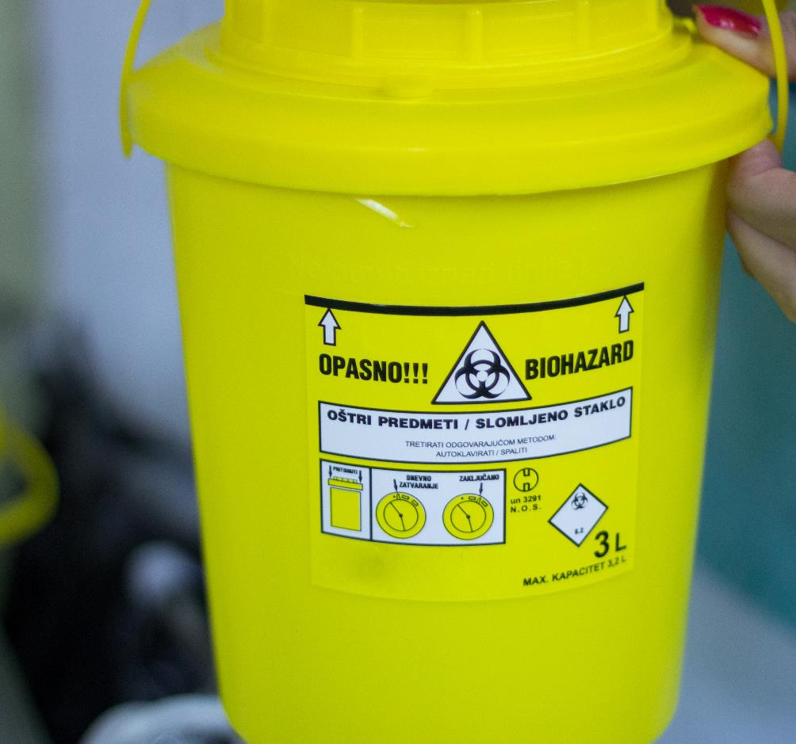
Top 5 OSHA Violations
The employer did not have a written Hazard Communication Plan that describes how it achieves compliance with:
1) Labels on hazardous containers;
2) SDS’s for all chemicals and pesticides; and
3) Hazardous chemical training for employees.

Slide 17
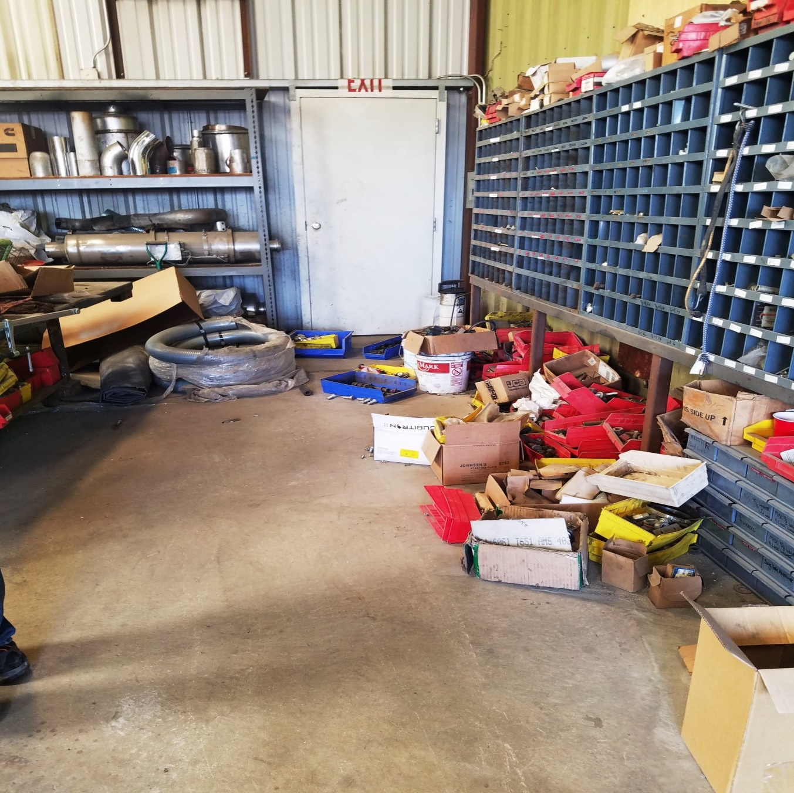
Top 5 OSHA Violations
The facility does not have required OSHA documentation related to workplace injury, OSHA Form 300, or Form 301 if injuries have occurred, on file.
The facility does not have a formal fire prevention plan that addresses major hazards in the facility, accumulation of waste material, maintenance of heat-producing equipment and names and titles of employees responsible for various parts of the plan.

Slide 18
Top 5 OSHA Violations
Required Personal Protective Equipment (PPE) has not been evaluated and documented, along with associated training plans and verification for employees.
All relevant employees have not been trained on hazardous materials in use at the facility prior to their initial work assignment and when new hazards are introduced.

Slide 19
Some of the Major Hazards
Compressed and hazardous gases
Electrical
Use of hazardous chemicals
Fire-Blocking Corridors/Exits
Injuries from not using proper Personal Protective Equipment (PPE)
Ergonomic injuries
Fall Protection including improper use of ladders
Indoor/Outdoor heat stress
Lack of written safety Plans (IIPP, CHCP, EAP, & Respirator Protection)
Drugs in the workplace
Lack of documented training

Slide 20
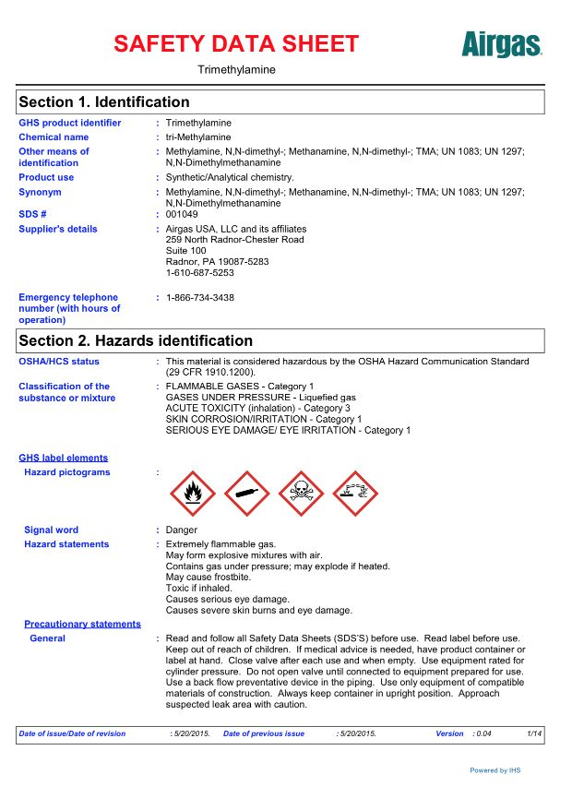
OSHA Safety Data Sheets/GHS Training
December 1, 2013 was the deadline for employers to provide appropriate training and ensure that employees have the information that they need to protect themselves from chemical hazards.
Employers had until June 2016 to update their hazard communication programs, signage, and training.

Slide 21
OSHA Safety Data Sheets/GHS Training
Updates to the SDS include:
Hazard classification: Provides specific criteria for classification of health and physical hazards, as well as classification of mixtures. 
Labels: Chemical manufacturers and importers will be required to provide a label that includes a harmonized signal word, pictogram, and hazard statement for each hazard class and category. Precautionary statements must also be provided. 
Safety Data Sheets: Will now have a specified 16-section format. 
Information and training: Employers are required to train workers by December 1, 2013 on the new labels elements and safety data sheets format to facilitate recognition and understanding.
http://lycaeum.org/~sputnik/Drugs/THC/msds.html

Slide 22
What do the States Say?
What does your Handbook say?
What does your Safety Program say?
Courts have said that asking a person to submit to a chemical test is the most intrusive search done by an employer!
OSHA recently came out with “guidance” in regards to drug testing.
Random drug testing has strict and specific requirements. Under most circumstances, employers must have “probable cause” to ask an employee to submit to a random drug test!

Slide 23
Pre-Employment Drug Testing
California employers may conduct pre-employment drug testing of all applicants before hire and deny employment if the drug test comes back positive, even if the applicant was legally using Cannabis under the state’s Compassionate Use Act, as affirmed by California’s high court in the 2008 decision of Ross v. Raging Wire, 42 Cal. 4th 920 (2008).
Any other states?

Slide 24
Post Accident Drug Testing – What OSHA Says
Employers need reasonable suspicion of drug use before testing.
Drug testing must be designed in a way that cannot be perceived as punitive or embarrassing to the employee and be likely to deter injury reporting.

Slide 25
Driving in the Workplace
If you are considering having employees drive for the business, there are some very specific requirements:
Handbook considerations
Job Descriptions
Safety considerations – safe driving
“5 Nano grams”- Presumptive level
Zero Tolerance
Forklift Certifications
State considerations may include:
Department of motor vehicles/Licensing
Random drug/alcohol testing
State/local issues
GPS/Cameras

Slide 26
Written Safety Plans
Safety requirements vary from state-to-state and must comply with a minimum of federal OSHA laws. For instance, in California and some other states, you must have what is called an “Injury & Illness Prevention Program”. Other written safety plans may include, but not limited to:
Chemical
Hazards
Emergency
Action Plan
Respirator
Protection Plan
Fall
Protection Plan

Slide 27
Safety Training
Besides having and updating your written safety programs you must, by law, maintain a documented safety training program in many areas, regardless of number of employees.
Training can vary from one training when the employee was hired, to annually every year, to every so often. Some safety trainings are state-specific.
Some states require that employees be trained in topics such as Outdoor Heat Stress, Fire Extinguishers, etc.
Training is not training unless it is DOCUMENTED!

Slide 28
Some of the Safety Trainings We Provide
Electrical Safety
Supervisory Safety
Personal Protective Equipment
Respirator Protection
Slips, Trips & Falls
Driver Safety
Ladder Safety Training
Chemical Hazards/GHS
Indoor & Outdoor Heat Stress
Fire Extinguisher Training
Working Outdoors
Lockout-Tagout (energized equipment)
Supervisory Probable Cause Drug testing, and many more!

Slide 29
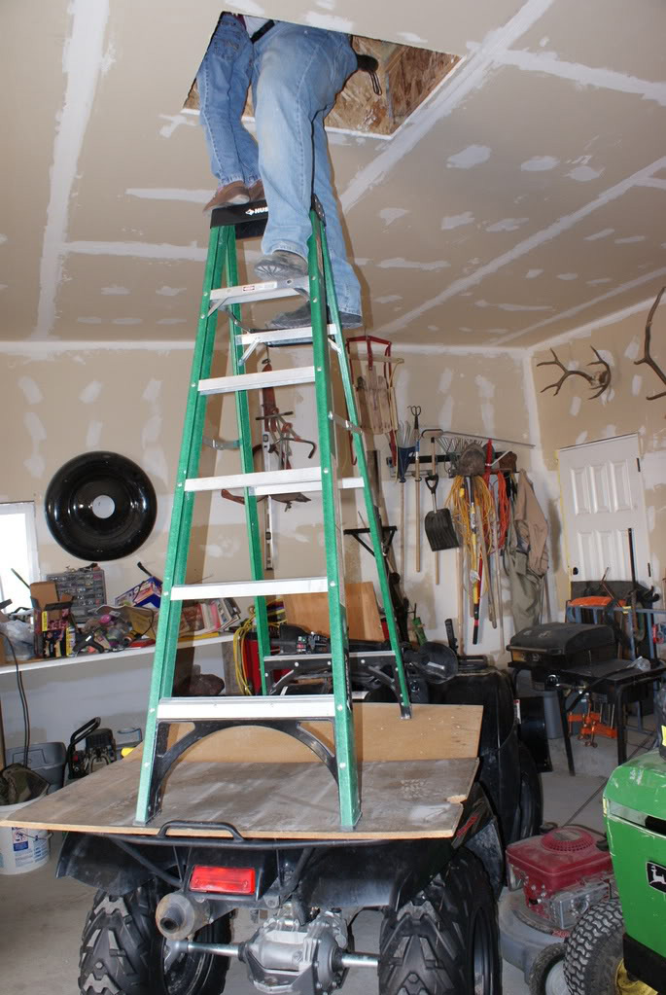
What is the OSHA “General Duty Clause”?
EACH EMPLOYER—
shall furnish to each of his employees employment and a place of employment which are free from recognized hazards that are causing or are likely to cause death or serious physical harm to his employees;
shall comply with occupational safety and health standards promulgated under this Act.
(b) Each employee shall comply with occupational safety and health standards and all rules, regulations, and orders issued pursuant to this Act which are applicable to his own actions and conduct.

Slide 30
OSHA Posting Requirements
OSHA, by law, requires most employers to post certain posting which include, but may not be limited to:
OSHA – It’s the Law!
OSHA 300A Form annually
Forklift Poster
Other states, by law, may also require specific posters to be posted by law.
OSHA does not require their posters to be published in other languages but highly recommends Spanish postings, if applicable.
State posting may be required to be in a language comparable to your workface!
Some posters may be required to be updated annually.

Slide 31
What is Workers’ Compensation
Workers’ Compensation is a form of insurance providing wage replacement and medical benefits to employees injured in the course of employment in exchange for mandatory relinquishment of the employee's right to sue his or her employer for the tort of negligence. Workers’ Compensation is nationwide!
Workers’ Compensation costs are a bottom line cost that can affect your profitability.
Reporting accidents to your Workers’ Compensation Carrier is very important to you, as if you do it properly (Exclusive Remedy Law), you cannot be held financially liable for the employee’s injuries.

Slide 32
Stratton Agency is Here to Help!
Various forms of insurances can be complicated. A future webinar will deal with your insurance needs. At that time, we will also introduce some of our dedicated people to you!
We will be able to answer some of your basic questions during this webinar and put you in touch with the right person here at Stratton Agency!
Look towards www.ninepointstrategies.com for upcoming webinar dates and team bios!

Slide 33
Obey All Laws!
You are a new and growing company in an industry that faces many challenges. There are people out there waiting for you to make a mistake.
Meeting federal, state and local employment laws is critical to your success.
Compliance saves you money and keeps you in business.
Besides, State Cannabis permits require you to “Obey All Laws”, and that includes OSHA laws!

Slide 34
Summary
Employers must comply with all federal, and OSHA and Workers’ Compensation laws!
OSHA regulations are some of the most complex laws that you will face.
Remember, OSHA can fine owners, managers and supervisors and even result in prison time!
To find out more, contact us at info@strattonagency.com.

Slide 35
Nine Point Strategies Team
For your Nine Points Strategies team, please contact info@strattonagency.com
As a full service vendor, we offer:
Insurance placement Specialists
Human Resources Specialists
Safety/OSHA Specialists
Benefits & On-boarding Specialists

Slide 36
Upcoming Webinars
In 2017, we will be offering monthly webinars focused on the Cannabis industry including:
Cannabis & Human Resources
Cannabis & OSHA safety
Cannabis and Immigration/I-9 issues
Ladder safety in March
Dressing/uniforms, etc. in March
Heat Stress in April
GHS Training in September
Please see www.ninepointstrategies.com
for more information and sign-ups!

Slide 37
UPCOMING FREE WEBINARS
During the 2017 Webinar Season, we offer mostly free webinars to our clients in regards to strategic major court decisions and applicable state law updates.
For information and how to sign up, please contact us at info@strattonagency.com
www.ninepointstrategies.com

Slide 38
Questions
If you should have any questions, please direct them to info@strattonagency.com. Please make sure you mention this webinar date and which company you represent. Also include your phone number as we may want to contact you for a more complete answer or question clarification.
If you are a current Nine Point Strategies Client, you may also contact your HR/Safety Representative at 925-556-4404.
www.ninepointstrategies.com

